Slide 1

The size of nations, the scope of government, the case of Liechtenstein

Slide 2
Content
Size and number of nations
Wealth of nations and size of the state: theories (Alesina et al., Rodrik, Armstrong, Easterly)
Modern empirical findings
The case of Liechtenstein
Free download at www.sous.li

Slide 3
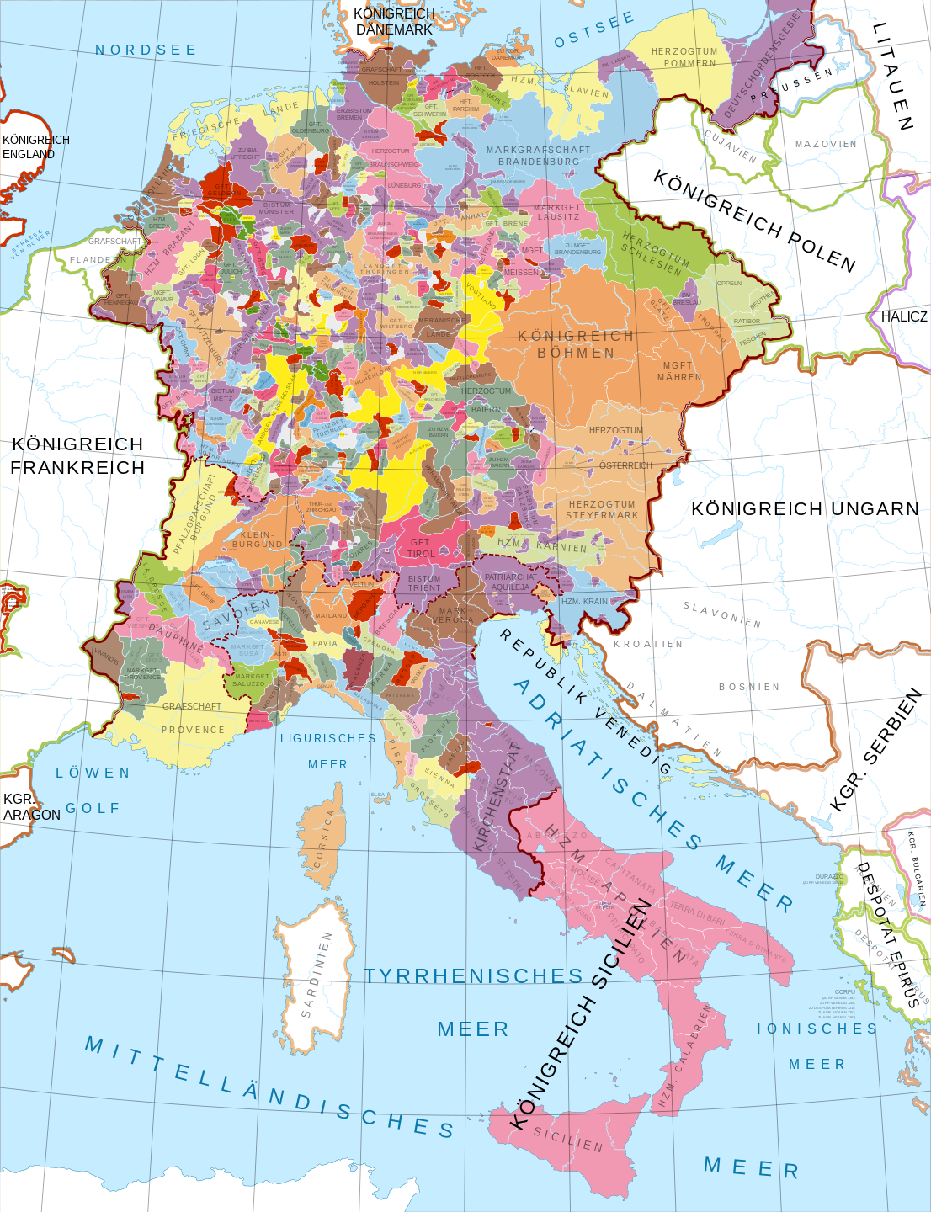
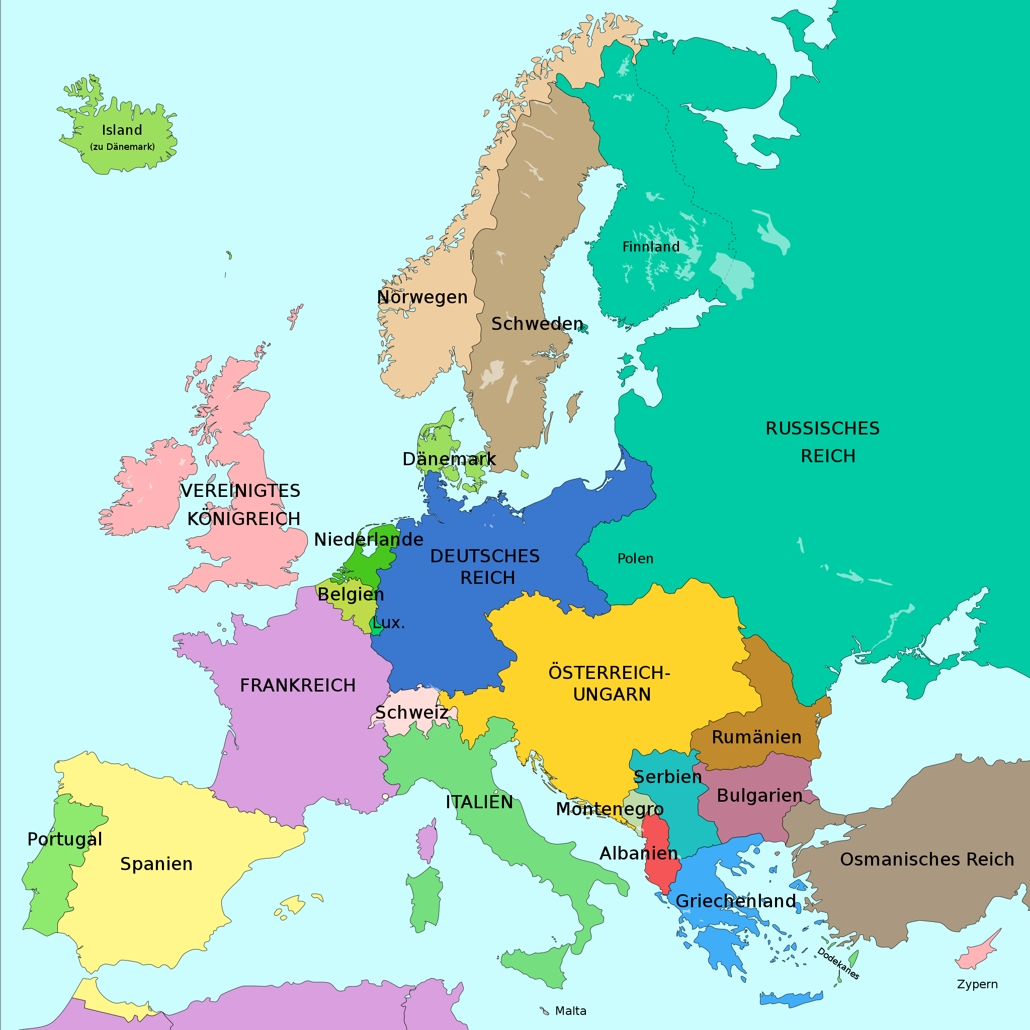
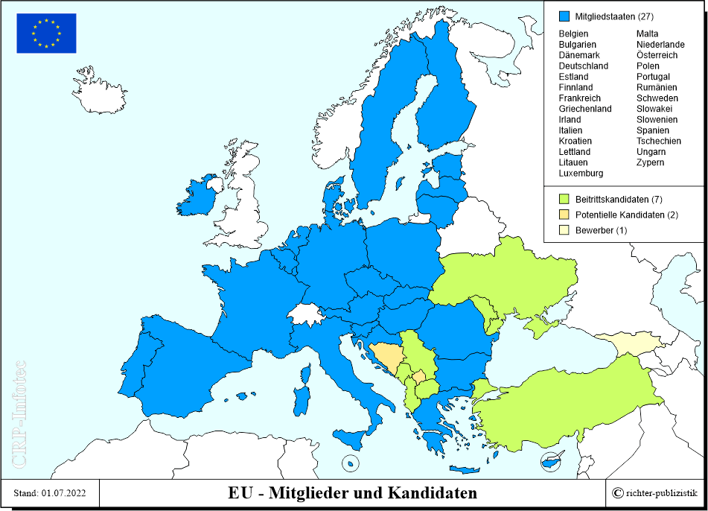
The size and number of nations
1648, 1914, 2022

Slide 4
Size and numbers of nations
Number of sovereign states increased from 74 (1948) to 193 (2001).
Over 100 with a population below 3 million.
Why?
  breakdown of Empires, decolonialization;
  second wave of globalisation;
  relative peaceful times
  Smart policies …

Slide 5
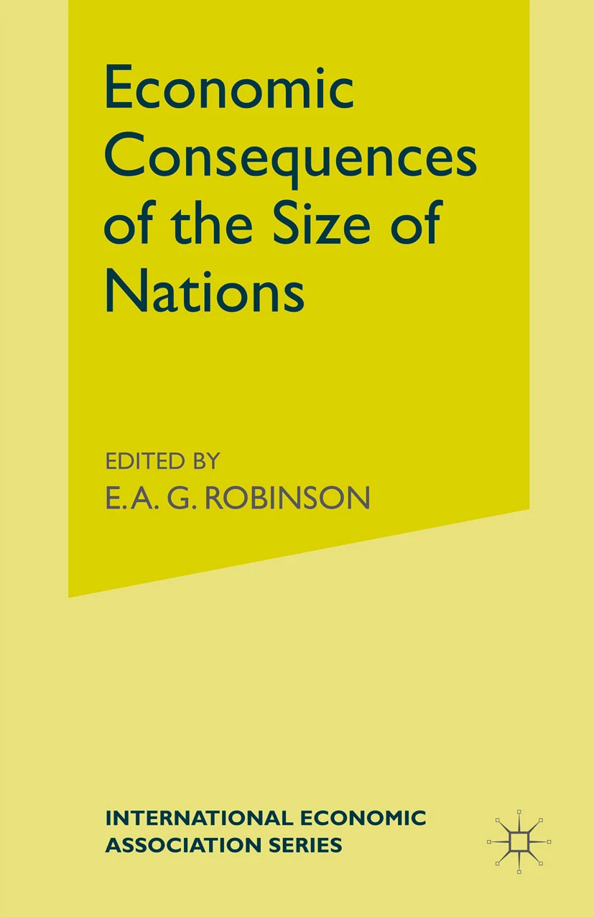
Wealth and government size of small countries: theory
Kuznets (1960):
Economic disadvantages:
less space for diversification, division of labour and for large scale production and organization; higher per capita costs for public good production (defence).
Political economic advantages:
more homogenous population, “closer internal ties”, (social capital), more adaptability and readiness to learn and reform. (s.a. Katzenstein 1985).
“Compensation hypothesis” (Cameron 1978; Rodrik 1989):
Higher state expenditures as insurance against external shocks (terms of trade vulnerability)

Slide 6
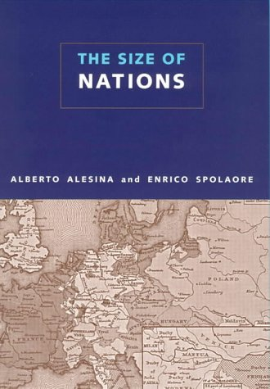
Wealth and government size of small countries: theory
Alesina / Spolaore (2003):
Benefits of size:
Economies of scale in the production of public goods: lower per capita costs in “general-policy coordination and administration, defense and foreign policy, a legal and judicial system, police and crime prevention, a monetary and financial system, infrastructure for communication, public health”
Cross-regional externalities or “shocks” (environmental, or “social”) can be better “internalized” (via regulation and redistribution).
Size of internal markets (s.a.)

Slide 7
Wealth and government size of small countries: theory
Alesina / Spolaore (2003):
Disadvantages of size:
“larger populations are associated with higher heterogeneity of preferences of different individuals. Being part of the same community implies sharing jointly-supplied public goods and policies in ways that cannot satisfy everybody’s preferences”. Large nations with “ethno-linguistic fractionalism” show less economic performance, economic freedom, and quality of government.
Imman/Rubinfeld (1997): citizens in small democracies can better observe and control government action.

Slide 8
Wealth and government size of small countries: empirics
Easterly / Kray (1999):
«In light of the grim predictions of theory, the picture of small states which emerges from this analysis is somewhat surprising.»:
Small states (< 1 mio 33/157, 1960-1995) have higher per capita income and life-expectancy and education levels.
The more they trade, the more they grow (but with higher volatility). «the positive effect of openness . . . is 2.5 times larger than the negative growth effect of small states' greater output volatility».
Krieger / Merierrieks (2020):
n=130, 1970-2014, irrespective of economic development smaller countries (esp. if <10 million) show also smaller government (exp./GDP).

Slide 9
Population size, wealth and government size

Slide 10
Population size, wealth and government size

Slide 12
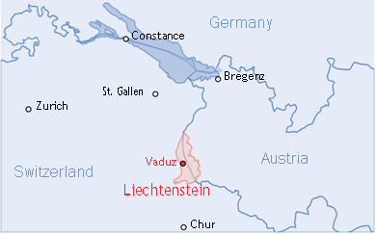
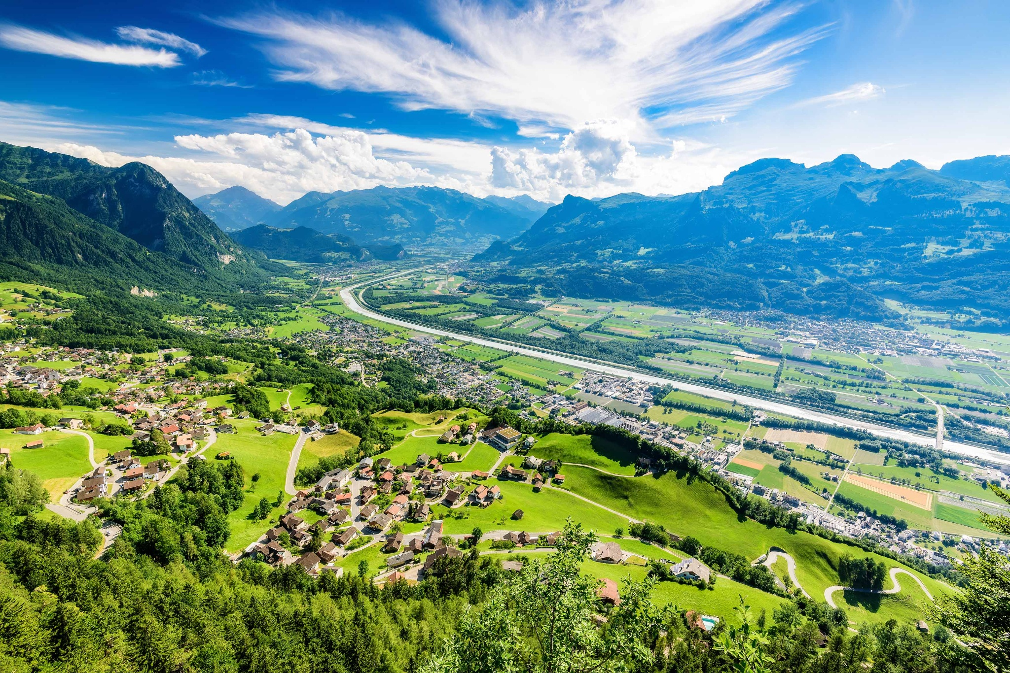
Introducing Liechtenstein
Only member state of „Holy Roman Empire“ to still exist with same territory since 1719.
1852: customs treaty with Austrian Empire.
1868: abolition of army.
1921: new constitution of “a constitutional, hereditary monarchy on a democratic and parliamentary basis”.
1924: customs treaty with Switzerland, Franc official currency.
1990: UN membership.
1991: EFTA membership.
1995: EEA, WTO membership.

Slide 13

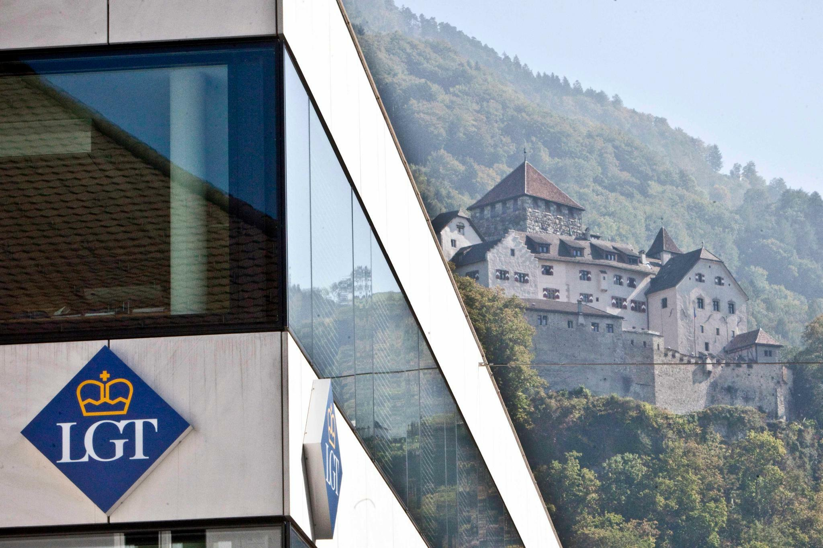
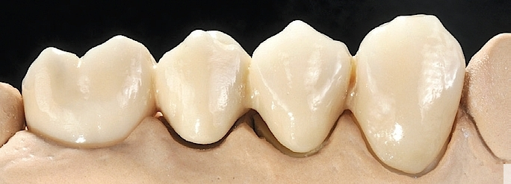
Introducing Liechtenstein more diversified than you may think

Slide 14
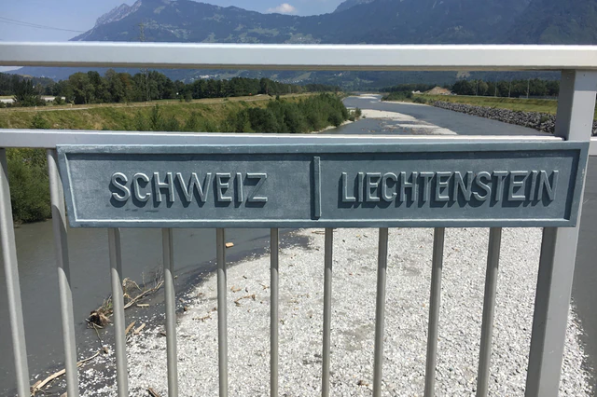
Introducing Liechtenstein higher employment than population

Slide 15
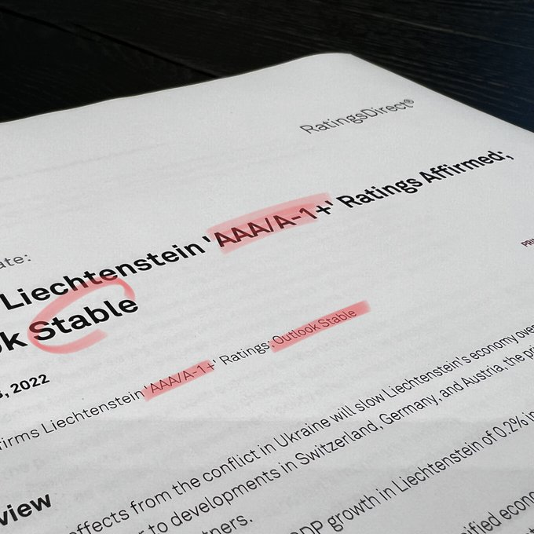
Introducing Liechtenstein: excess revenues = 3 yearly budgets

Slide 16
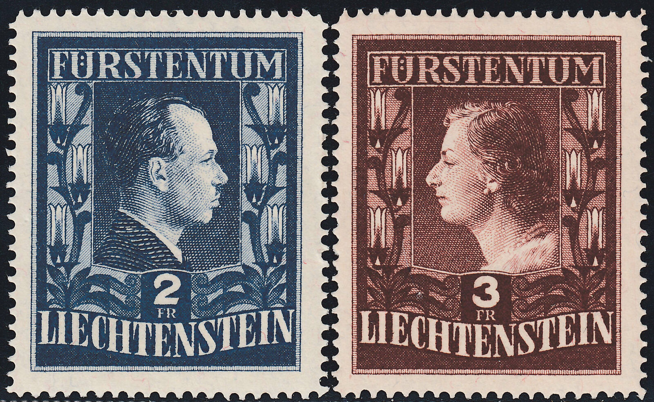
Explaining the small rich state:
Smart fiscal policy
Art. 24 (2) LV: “The financial situation of the State must be improved to the utmost possible extent and every effort must be made to open up new sources of revenue to meet public needs”.
Stamps, Casinos, corporate tax-regimes and philanthropy environment (Laffer curve).

Slide 17
Explaining the small rich state:
Outsourcing, multitasking
Ostrom/Ostrom (1977): state as „provider / arranger“ not „producer / supplier“ of public goods. Outsourcing
  To neighbouring countries: money, defence, universities, rail and air traffic, postal services, telecom, clinics, diplomatic services …
    Free-ride? (paid, little extra costs for neighbours).
  To private sector: franchise bidding for local bus service; local charity in social services, culture and education.
  Mixed forms of public/private ownership (Landesbank, utilities).
    Often with high dividends out of cross-subidization: „win-win“ or obstruction of competiton?
Multitasking:
  5 ministries, politicians with business background.

Slide 18
Explaining the small rich state: smart „industrial policy“
General location factors:
  central location, neutrality, political, legal and social stability …, strong and stable Swiss franc, full access to EU single market, EFTA and CH trade deals, good infrastructure (telecom)
Liberal policies:
  Open markets, low taxation, high banking secrecy [compliance], low compliance costs, easy access adminstration (e.g. for start-ups), Top World Bank „Governance Indicators“.
High targeted investments
  in R&D (6.5 % of GDP in 2019, mostly from private sector).
  in education (also good PISA scores)
  in international reputation

Slide 19
Prince and People as veto players?
Franz Josef II. encouraged state action (social insurance) in the 1950s to 1980s.
Hans Adam II advocates a strong liberal interpretation of „subsidiarity“ (state as „service enterprise“; local responsibility for social care; education vouchers …)
Direct democracy similar to CH as brake on government expenditures, debt and tax increases.

Slide 20
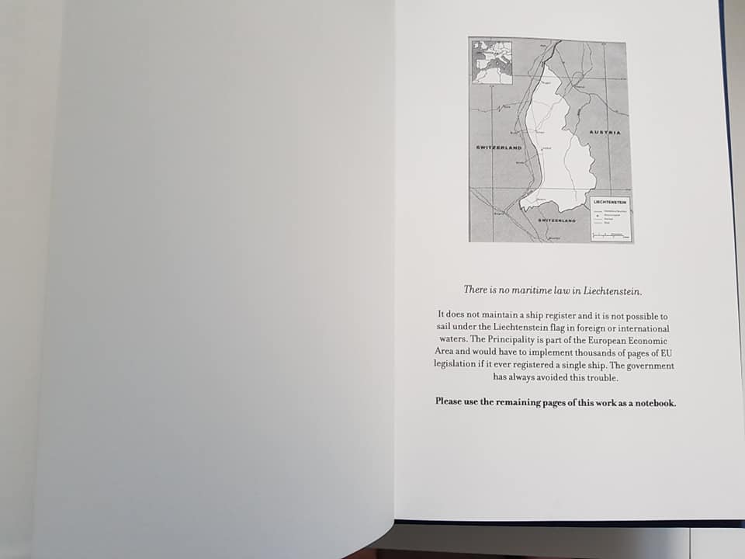
Imported government growth?

Slide 21
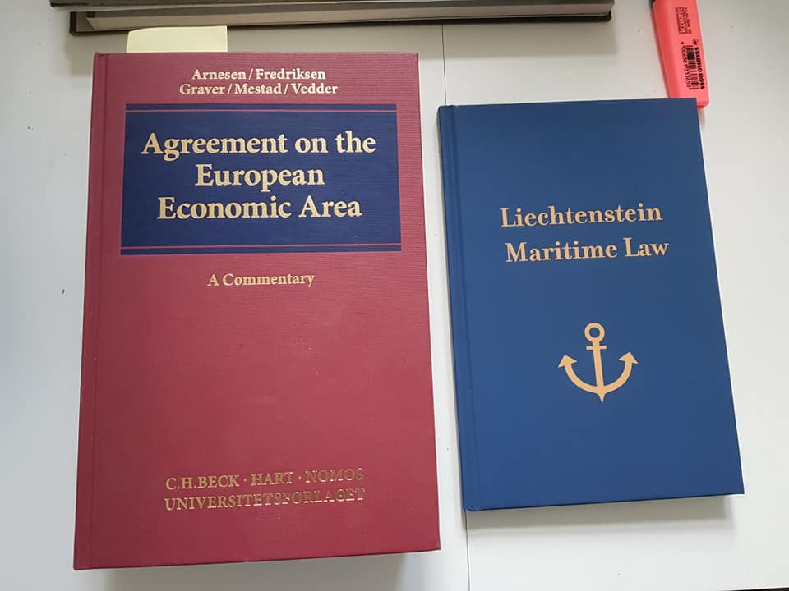
Imported government growth?
EEA laws and regulations:
  2020: 10.500 legal acts based on EEA law (1/3 of total LI law)
  More „single market relevance“
  From directives to regulations and delegated decisions
  More agencies
  LI: copy-paste legislation, „foreign judges“ and experts, multi-tasking.
  Issues of “size compatibility”. But overall: EEA (and Schengen) great benefit for LI.

Slide 22
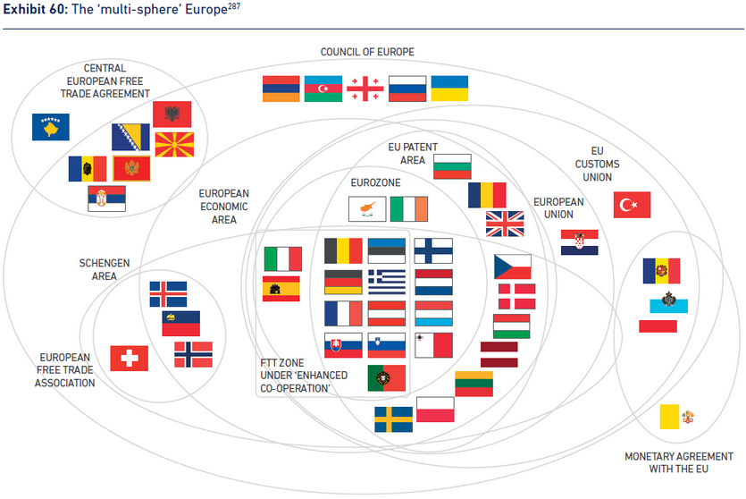
„United in diversity“
Notes:
Paradebeispiel Euro-Club: (zu) leicht hineinzukommen; (zu) schwer, herauszukommen.

